Slide 1
College Social Media App and it’s Automated Generation Group -04
Group Members
Divya Peter
Eljo joy
Akash Kumar
Jackson James
Github Repolink : https://github.com/jaxonzku/Group04
Guide : Mr Shaiju Paul

Slide 2
Abstract
In the early 2000s, the primary purpose of mobile phones was to communicate by calling or texting an interlocutor
Mobile phones have become tools that have changed our world, allowing users to entertain themselves learn, and search for information faster and more efficiently
Our project is a platform for generating applications for educational institutions
With short time and limited expense for maintenance

Slide 3
Objectives
To access the application easily to every colleges
To reduce the time taken and the cost needed for creating a social media application
To create an application that supports multiple platforms

Slide 4
List of literature papers reviewed
Application of Low-Cost Methodologies for Mobile Phone App Development
Simulating User Interactions: A Model and Tool for Semi-realistic Load Testing of Social App Backend Web Services
Efficient Way Of Web Development Using Python And Flask
An Empirical Evaluation of the User Interface Energy Consumption of React Native and Flutter
An Introduction to Hybrid Platform Mobile Application Development

Slide 5
SRS
Website - For the users to input the institution details
Mobile Application - prebuilt social media application files which is not compiled(flutter)
Server – a server which can compile flutter application , run python scripts (AWS)
Database – a database for holding user and institutional data
Storage –which stores user data like images and videos
Application – which will be compiled in the server.(Android and IPhone)

Slide 6
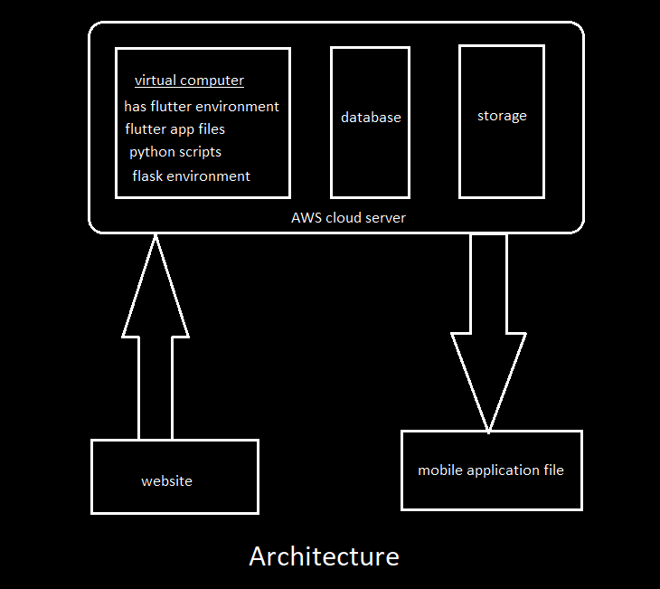
Architecture

Slide 7
What we have done so far
Client side :
Created a website for user to provide the details (basic).
Server side:
Created an AWS server (EC2) and installed flutter and python environment.
Created a basic flutter app template for testing purpose and added to server.
Placed the website files in the server for hosting directly.
Created python script for automatic compilation of flutter app.

Slide 8
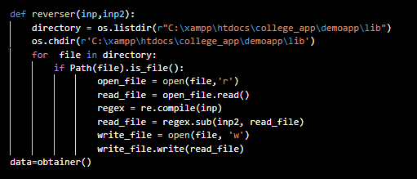
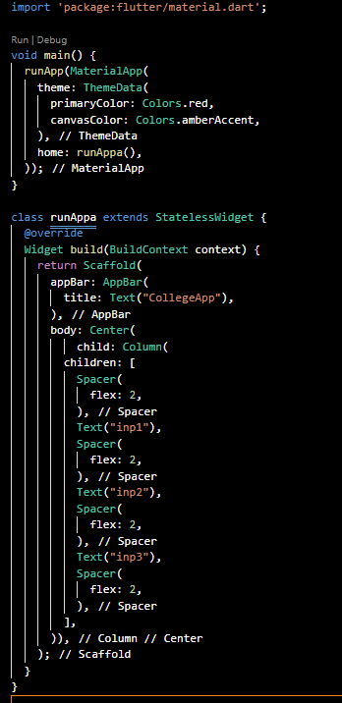
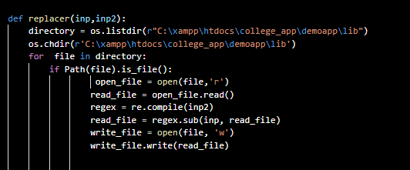
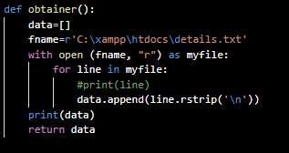
Important Codes
Python
Flutter

Slide 9
Results / Outputs
Website - which can access user data and convert it into a text file
Server :
which can compile flutter apps
run python scripts
host web-files
created a flutter app automatically by using python script with exact details given in website.

Slide 10
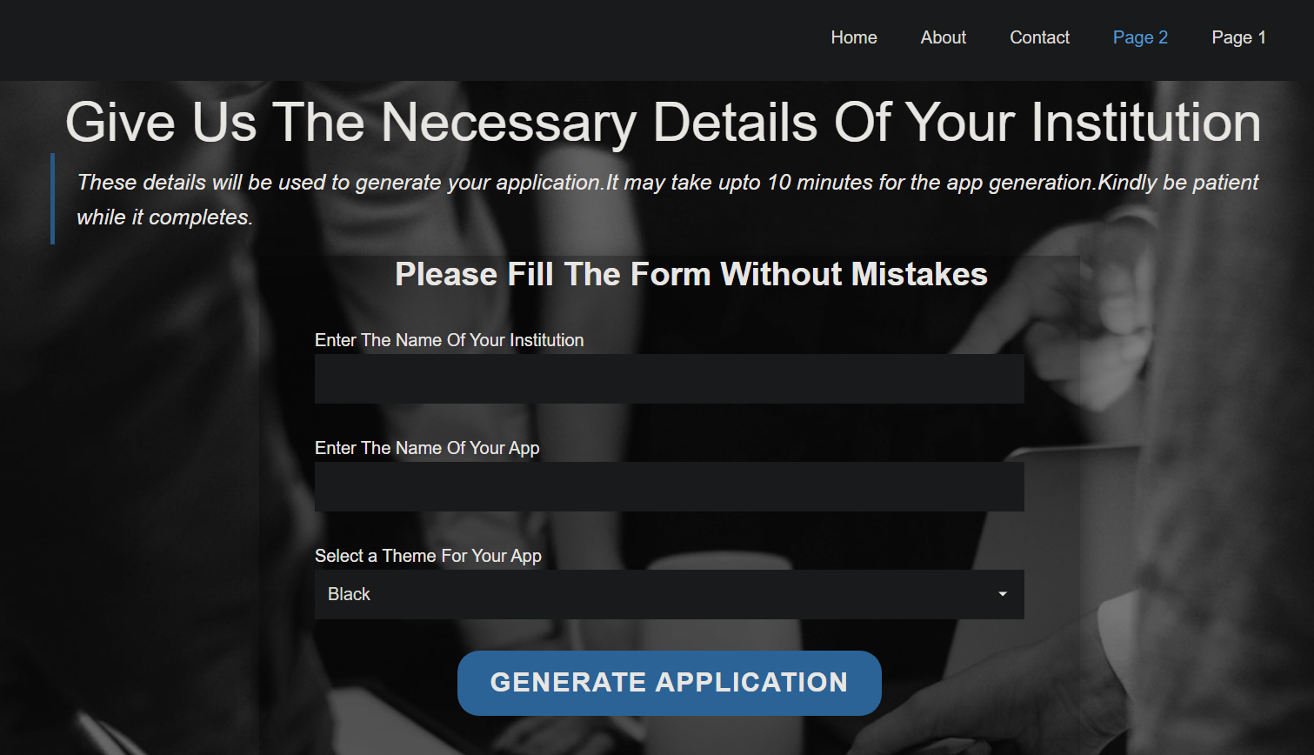
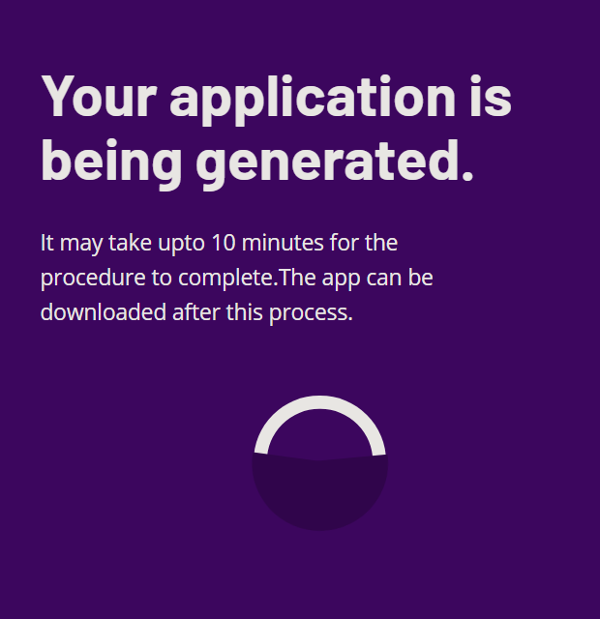
Results / Outputs cont..
Webpages

Slide 11
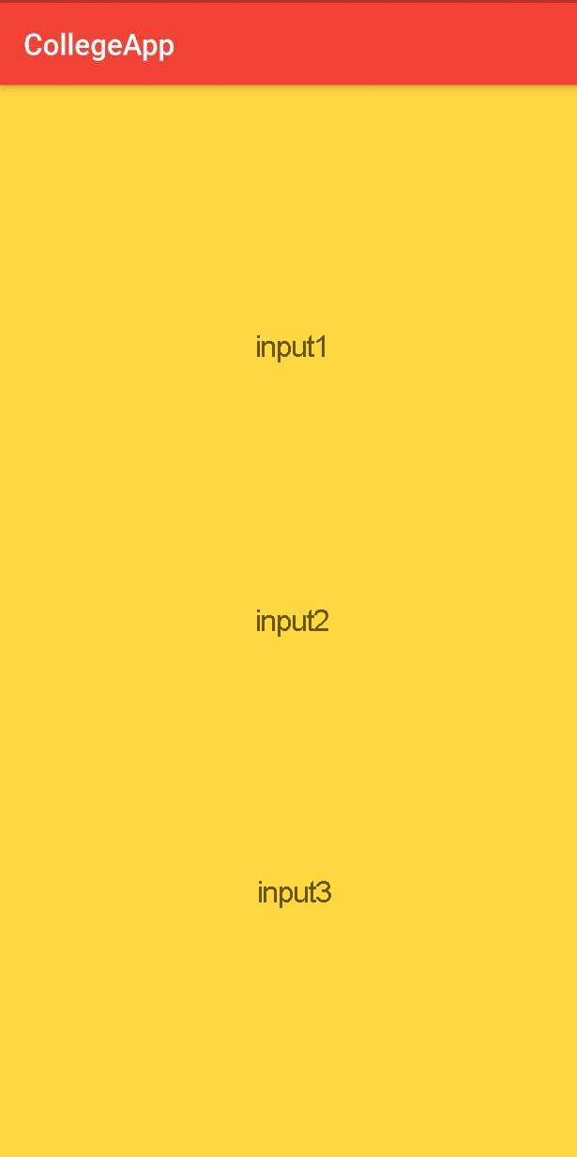
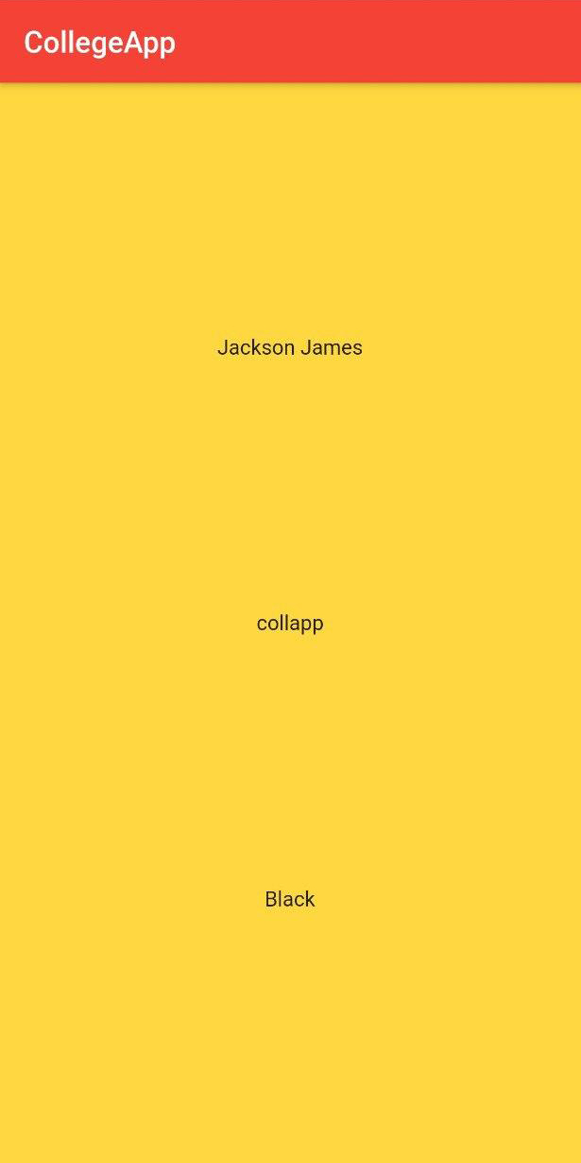
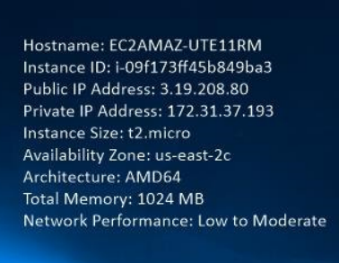
Results / Outputs cont..
Before
After
Virtual machine specs

Slide 12
Contribution of each members
Divya Peter : Flutter app template
Eljo Joy : Website design
Akash Kumar : Php
Jackson James : Server side and python script

Slide 13
Pending Implementations
Social media application using flutter
Connecting database and storage to the application
SSL certificate for server
Hosting the website

Slide 14
Conclusion
So far we have made a automated flutter application building environment.
This method can also be applied for any other applications by making changes in the scripts.
Virtual machine in the server has low specs , there is a possibility for taking long time for building application.
Security is too low while hosting through xampp server.
Server is running on free tier .Overuse of resources which is not in the free tier may increase the server charges.

Slide 15
THANK YOU

